Slide 1


Database Management and Security
Genesis Grant
CTEC 226-101
03/17/23

Slide 2





Introduction
Databases are integral systems when looking to store, retrieve and filter large amounts of information. When used correctly, these systems allow for a more organized and secure way to collect and run businesses. This presentation will describe the different types of database management systems, security concerns and adjoining procedures.

Slide 3

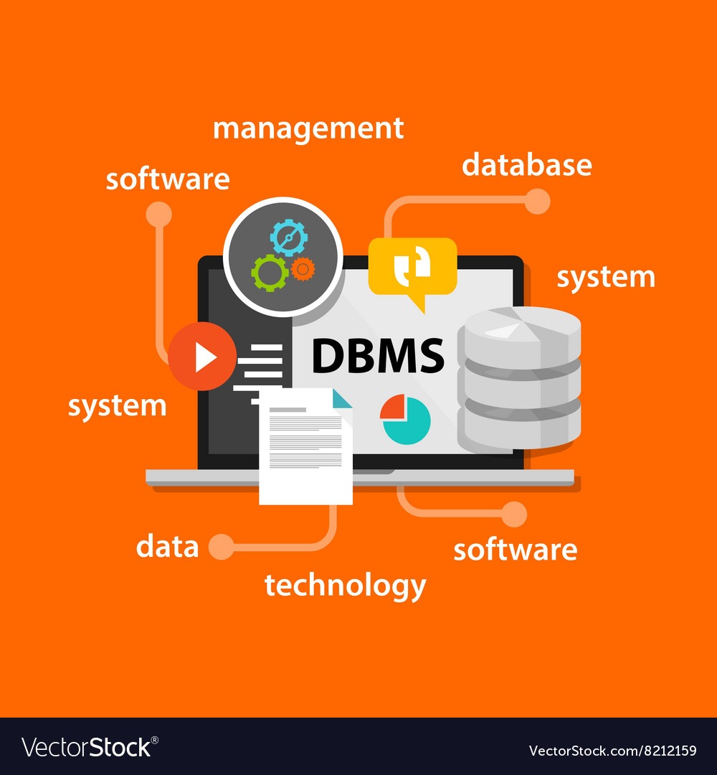
What is a DBMS?
A Database Management System (DBMS) is a system or group of programs that specialize in collecting, filtering and controlling who can access the stored information. DBMS are more efficient than regular spreadsheet software like Excel as they have more features, security and consistency.

Slide 4
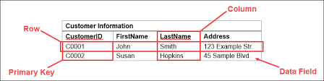
Relational Databases
Relational databases are used to store data that may relate to each other in some way(s). For example it may contain customer information as well as payroll, inventory, addresses, orders, etc. They are very simple to use and reliable.
They are constructed in rows and tables (similar to spreadsheets)
Each row has a unique identifier with its adjoining records/information.

Slide 5
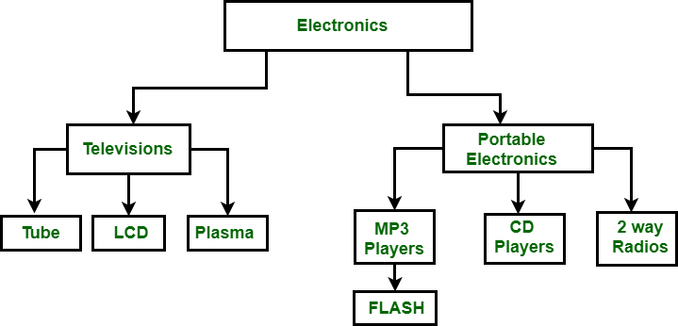
Hierarchal
Certain databases will store data in a hierarchal structure.
Information can relate or connect to one and other through links.
This structure is beneficial as it can show connections and overlaps in data.

Slide 6
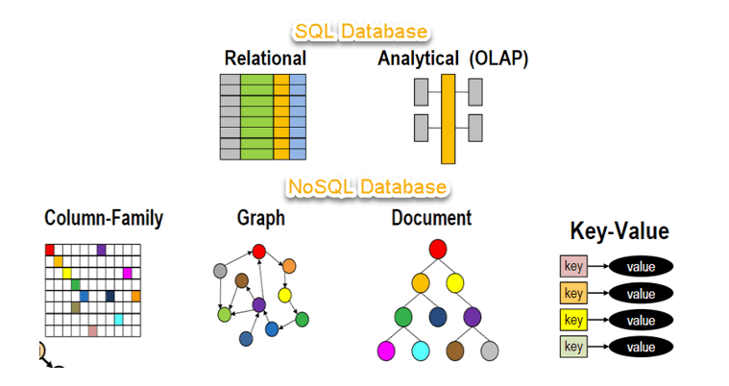
NoSQL Databases
Instead of storing data in tables like relational databases, noSQL databases will store databases in documents, graphs, wide columns, etc.
Avoids joins, does not create links in data
Good for big data and real time web apps

Slide 7
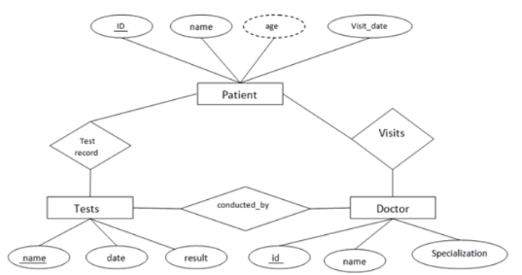
Object Based
Each entity is classified as an object. This allows for easier assortment and organization into other classes, subclasses and tables.
Object Based models focus on how the information is presented and connected.
Visual

Slide 8
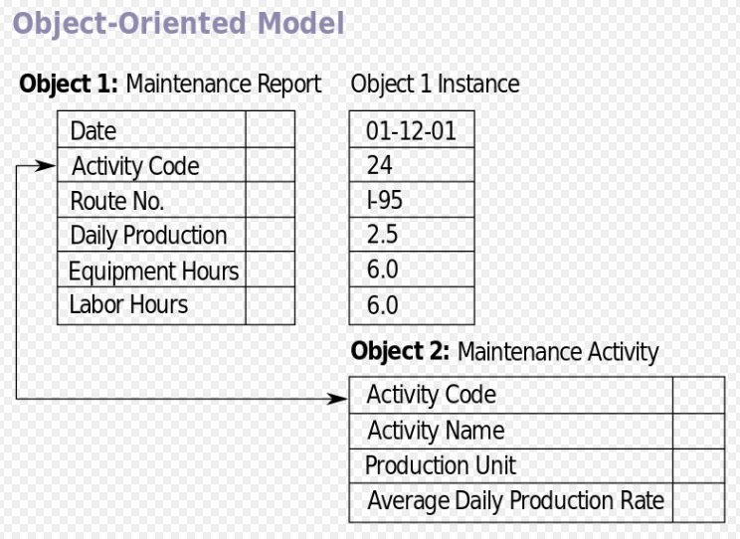
Object Orientated
Shows the data, any methods that can be used with it, connections, etc.
This database structure is based on object orientated programming, each entity is independent and can be maneuvered by links, join, etc.
Most beneficial when showing connections and visualizing data and all information.

Slide 9
Distributed
Distributed databases allow data to be distributed amongst multiple computers and/or servers.
MongoDB and Hadoop handle large amounts of data that can then be used to store and retrieve entities from large databases (MongoDB) then processed (Hadoop)
Would ideally be used if multiple users would need access to data across different locations as well as if there was large amounts of data to be accounted for.

Slide 10
What is Database Security?
Database security is the procedures and standards that databases must follow in order to ensure consistancy and protection.
These rules are important to maintain structured databases that are easy to maneuver and update, as well as control access.

Slide 11
Database Security Concerns
Inference: attackers can infer/educatedly guess passwords, vital information, etc. from open data. This can lead to secure data being exposed and potentially leaked.
To combat these attacks, ensure complex passwords and do not allow vital information to be publicly accessible. Authentication applications allow security as well.
Aggregation: Data, information (passwords, emails, phone numbers, etc.) that were gained from another account, website, application that is used to gain access into a separate application. These could potentially attack coworkers, friends, etc.
To combat these attacks, enable two factor authentication and be sure to have access into emails, phone numbers, etc. So you are able to go back and change any information and potentially block the attacker.

Slide 12
Database Security Concerns cont.
Injection: Unauthorized attacks where attacker can inject code or malware into programs, databases, etc. To view or modify the information within.
To combat these attacks be sure to have code or protections in place to block any foreign entities. Unsecure code/databases are easy to inject malware as they are unprotected.
Data Corruption: This type of security concern can come from mistake by the user. Data corruption can occur from mistakes with inputting/importing data, manipulating and/ or updating data.
To combat these attacks ensure you are carefully looking at data and fine proofing any final updates.

Slide 13
Database Security Concerns cont.
Unauthorized Access: This concern can include passer bys looking at unprotected data, attackers that have gained access, etc. Anyone except the user the data is being used by.
To protect against unauthorized access ensure data is protected by a complex and secure password as well as locking computers and/or closing tabs when leaving the computer.
Hashing and Encryption: Hashing and encryption are used to change information into different values for security purposes.
To protect oneself, create your own encryption! Allow for your data to be secure and protected.

Slide 14
Database Access Controls
What are Database Access Controls? These are tools that allow the administrator to control who has access into the data. This can be beneficial if the user only wants certain groups of people (coworkers, family, friends, programmers, etc.) to be able to modify and see the data.
Discretionary Access Control (DAC): Only allows access to the data to the administrator/user and anyone who the administrator/user chooses to give control over to.

Slide 15
Database Access Controls cont.
Mandatory Access Control (MAC) : Access control that all users must follow. Unlike DAC where one user can give control, all users follow the same constraints.
Role Based Access Control (RBAC): Users will have specific roles that they are assigned to and based on those roles will be given certain abilities in order to accomplish their tasks.
Clark-Wilson: Very restricted access, only limited actions are allowed by authorized users. Similar to some homework assignments where you can do limited actions in order to prevent any changes to the integrity of the database.

Slide 16
References
Clark and Wilson Model. (2011). Springer Link. https://link.springer.com/referenceworkentry/10.1007/978-1-4419-5906-5_814#:~:text=Definition,explicitly%20authorized%20users%20on%20resources.
Gallo, K. (2022, August 24). What Is Hashing? A Guide With Examples. Built In. https://builtin.com/cybersecurity/what-is-hashing
IBM Documentation. (n.d.). https://www.ibm.com/docs/en/tnpm/1.4.2?topic=data-aggregation
CSRC Content Editor. (n.d.-b). mandatory access control (MAC) - Glossary | CSRC. https://csrc.nist.gov/glossary/term/mandatory_access_control
NoSQL Databases: How Does it Work & Structure Examples. (2023, February 16). Couchbase Website. https://www.couchbase.com/resources/why-nosql/#:~:text=NoSQL%20databases%20store%20data%20in,column%20databases%2C%20and%20graph%20databases.

